Slide 1
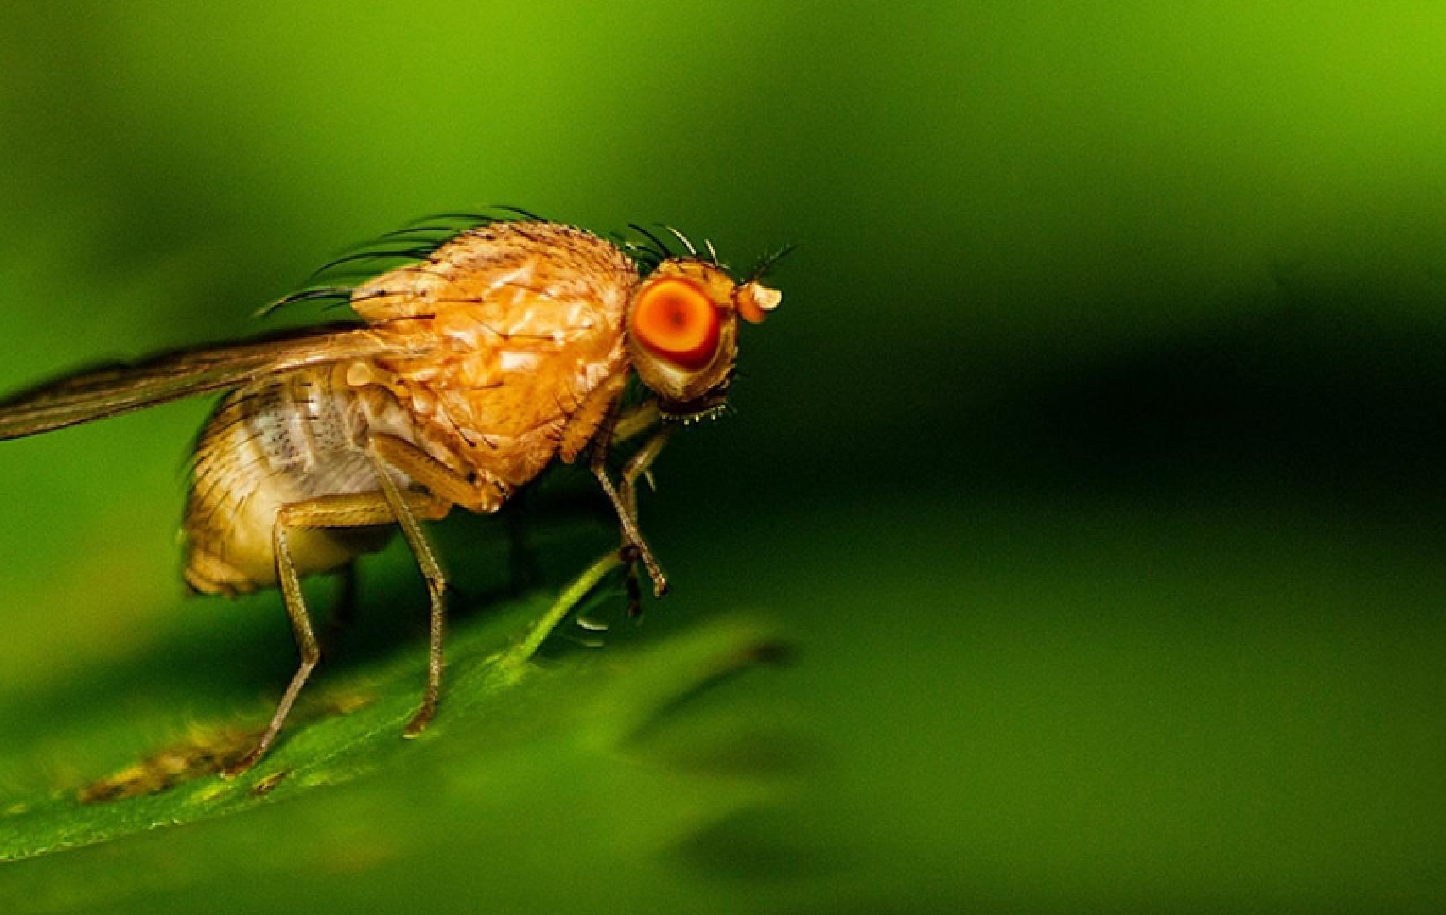
Replicability in experimental life sciences
Désirée Popelka
Blandine Ribotta
Bruno Lemaitre
June 2024

Slide 2
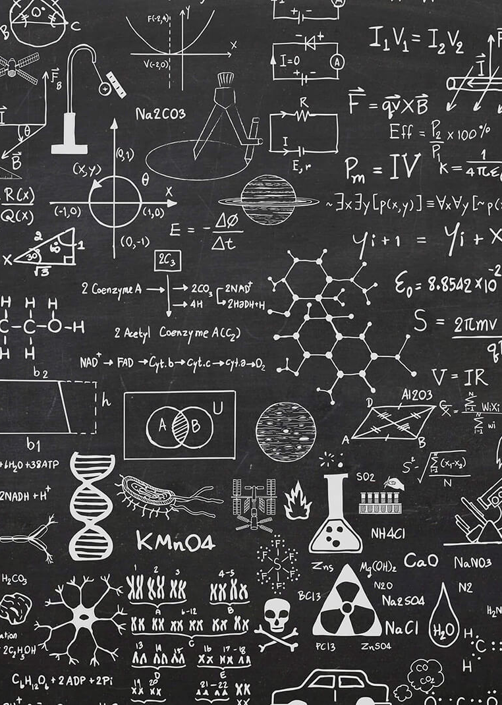
OUTLINE
Background Information
Metascience Part
Psychology Part
Closing & Next Steps

Slide 3
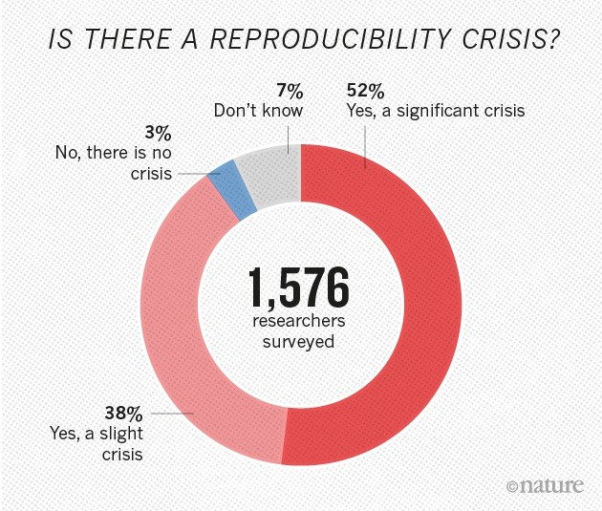
Background information
Is there a reproducibility crisis?
More than 70% of researchers have failed to reproduce another scientist’s experiments; more than 50% have failed to reproduce their own (Baker 2016)
Two pharmaceutical companies, Bayer and Amgen, reported reproducibility rates of 11% and 25% for dozens of ground-breaking studies in cancer and related areas (Prinz et al., 2011).
After eight years of investigation, a reproducibility project in cancer biology was only able to repeat 50 of 193 experiments from 23 of 53 high-impact papers (Errington 2021; Ioannidis 2022).

Slide 4
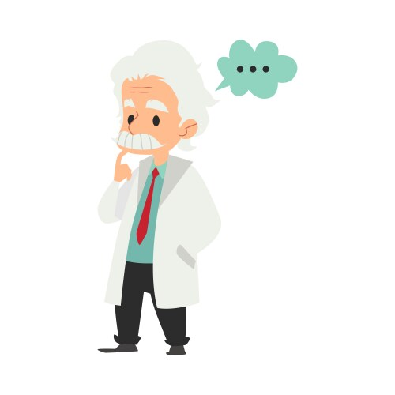
Background information
Why does irreproducibility happen?
Science is by nature a process of trial and error and proceeds by incremental improvements of understanding (Shiffrin et al., 2018)
A lack of reproducibility can be due to many factors:
Outright fraud (fabrication or intentional manipulation of data)
Misuse of technical tools
Spoiled reagents
Bias in data reporting
Lack of statistical power or misuse of statistics

Slide 5

Background information
Why does irreproducibility happen?
Some non-scientific factors contributing to reproductivity include:
Budget constraints
Competition, or a push to publish to acquire funding
Prestige associated with publishing novel or exciting results
Lack of interest in publishing studies with negative results
Consequences of irreproducibility:
Erosion of trust in science by the public
Wasted research money and time
And more…

Slide 6
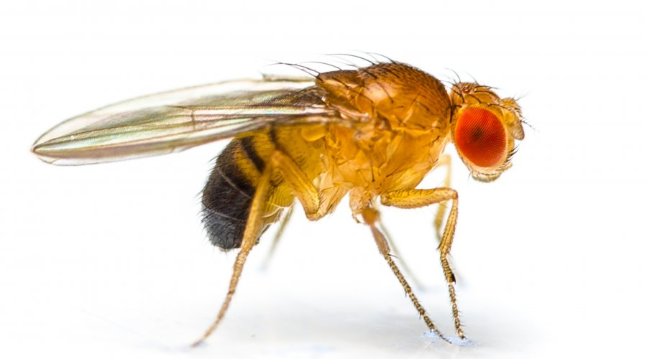
Background information
Our reproducibility study
Drosophila immunity represents a relatively small and therefore approachable area of study
We are interested in the accuracy of the conclusions rather than reliability of the methods:
We use replicability to test conclusions using newer methods and materials (E.g. CRISPR)

Slide 7

Background information
The three pillars of our reproducibility Project
Science
Metascience
Psychology
Focus of Today
To provide information on the validity of claims in the field of Drosophila immunity.
To describe the pattern of irreproducibility in a field of experimental research.
To understand how the scientific community deals with irreproducibility and the self-correcting nature of science.

Slide 8







Background information
Method
Verification: Verified, challenged, partially verified, unchallenged, etc. based on literature
Data analysis: in progress
Generating a list of papers: 400 articles (1950-2010)
Generating a Database
Annotations: Manually extract main, major, and minor claims
Opening ReproSci website to the community on July 5th 2023
Experimental tests of 30 unchallenged claims – by the lab and other labs

Slide 9

Background information
The database website

Slide 10

OUTLINE
Background Information
Metascience Part
Psychology Part
Closing & Next Steps

Slide 11
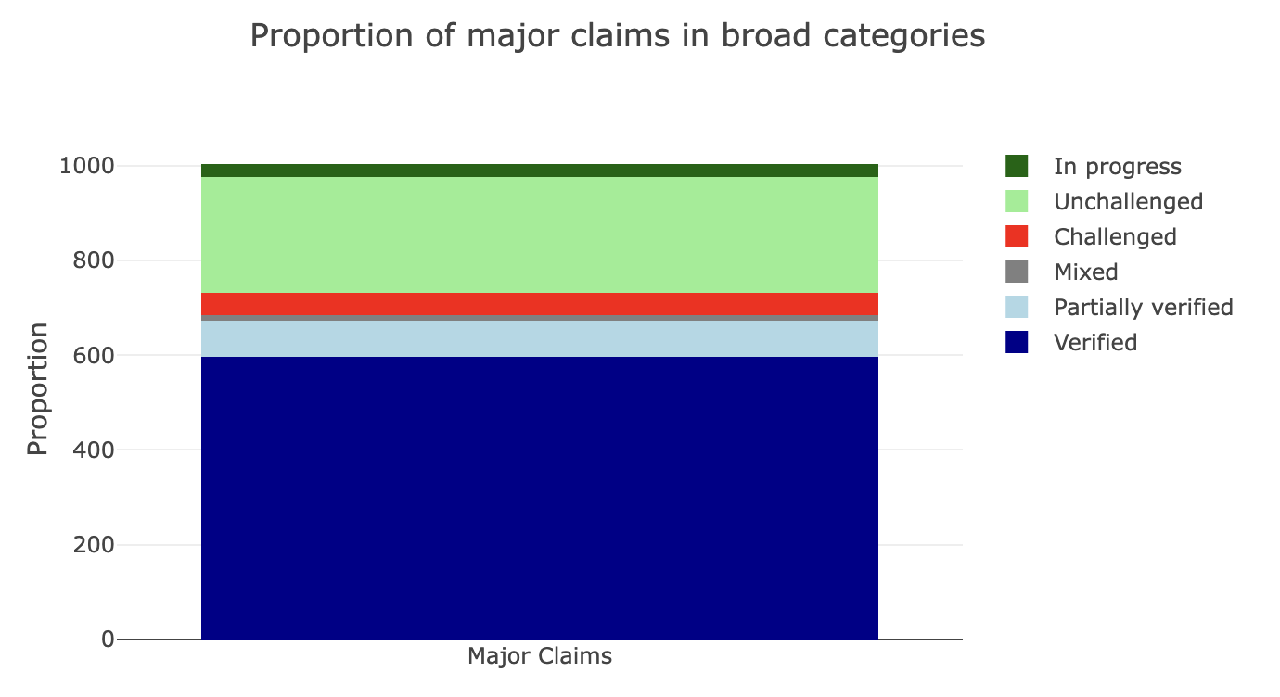
Metascience
Preliminary results of the ReproSci database
About 59% of major claims are strongly verified by the literature
8% have insightful data with incomplete interpretation, or incomplete data with insightful interpretation
About 3% are strongly challenged
About 20% have never had published follow-up (how do we know this? Can I delete this?)
1% are very tricky problems with conflicting data

Slide 12
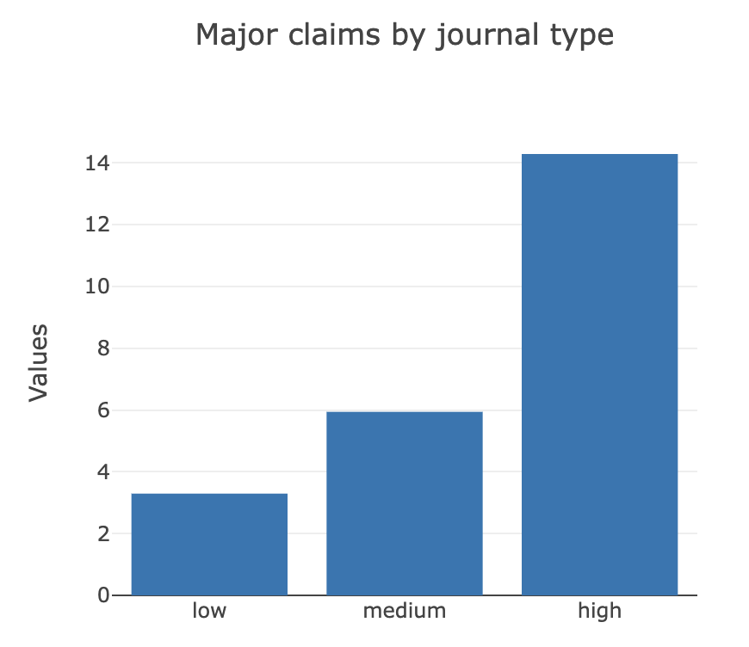
Metascience
Irreproducible claims per journal type
Legend:
High = Impact factor >50
Medium = Impact factor 10-50
Low = Impact factor <10

Slide 13
Metascience
Claims challenged by the ReproSci Project
 | Total number | Nb replicated by ReproSci | Nb verified by ReproSci | Nb challenged by ReproSci | % of claims not replicable by the ReproSci
Major claims | 1003 | 19 | 1 | 18 | ~95%
=> Conclusion: a significant fraction of originally unchallenged claims are likely to be wrong!

Slide 14
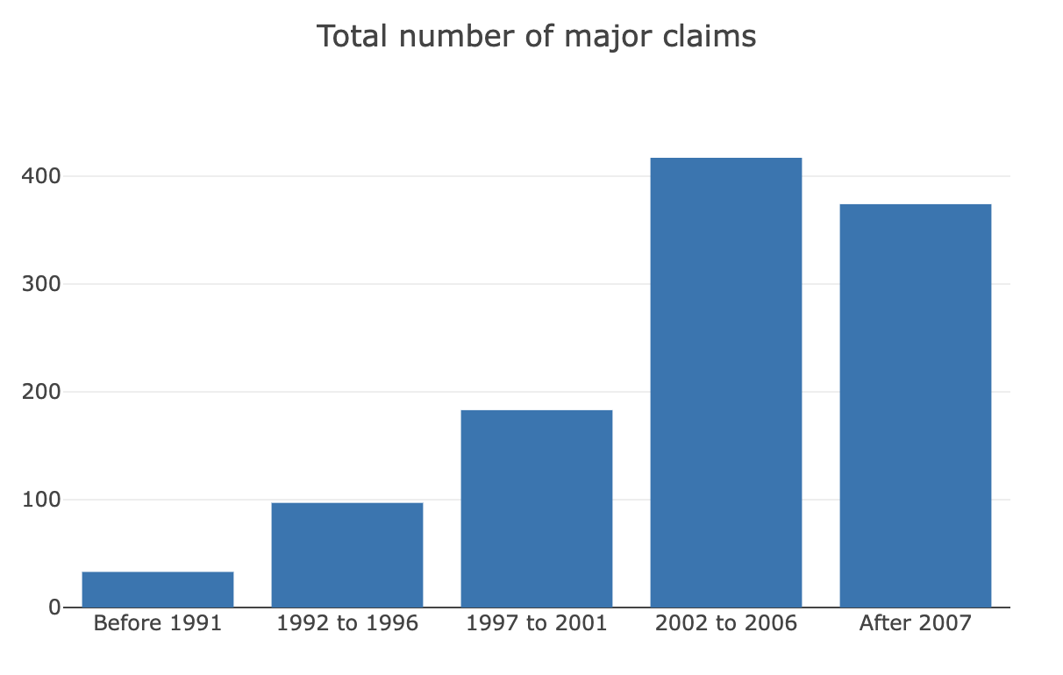
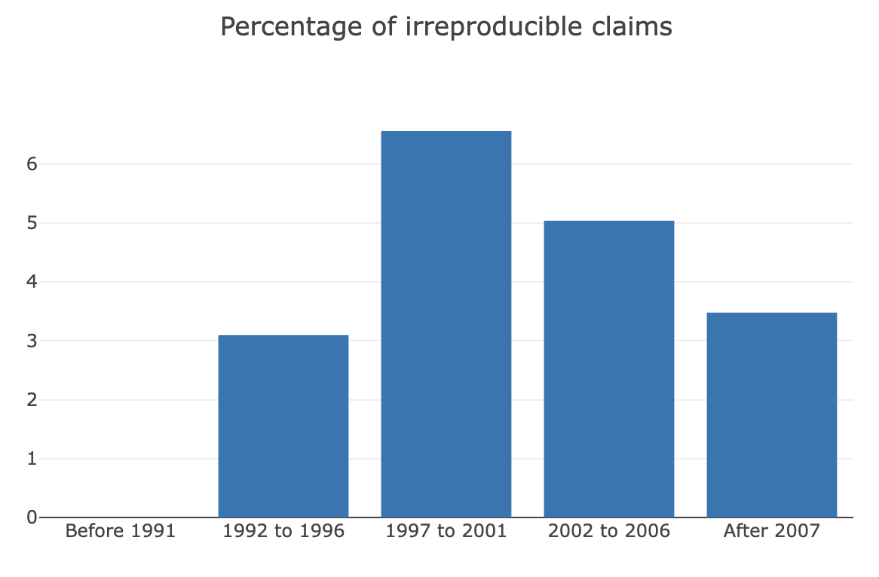
Metascience
Peek irreproducibility

Slide 15

OUTLINE
Background Information
Metascience Part
Psychology Part
Closing & Next Steps

Slide 16
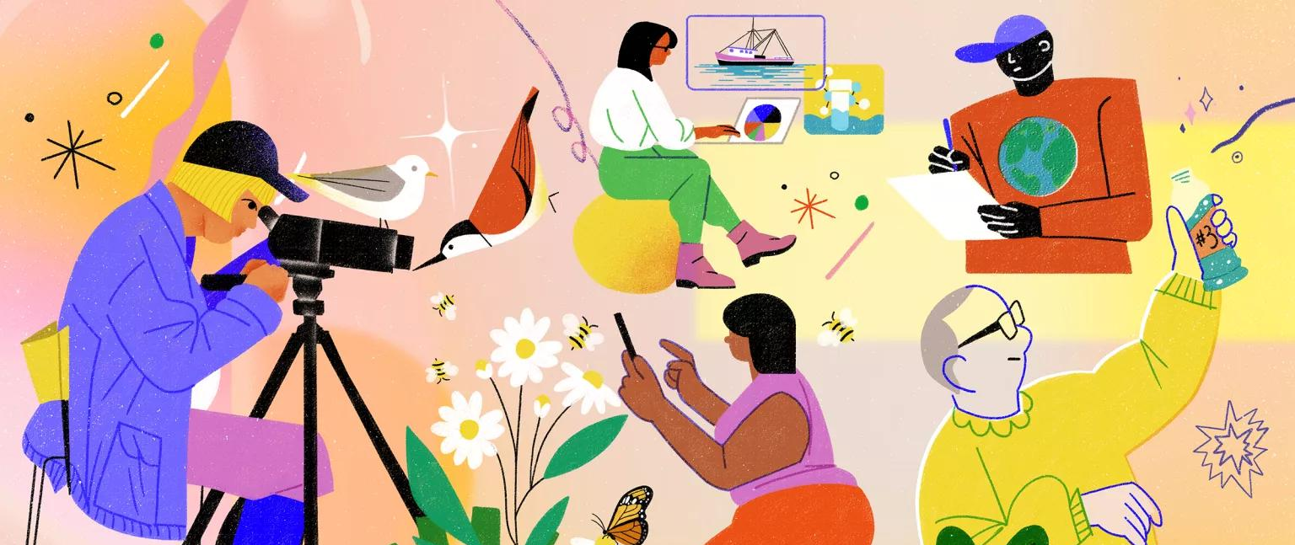
Psychology Part
Survey with the science community: preliminary results

Slide 17
Psychology Part
Description of the participants

Slide 18
Psychology Part
Description of the participants continued

Slide 19
Psychology Part
Perceived replicability crisis in the field

Slide 20
Psychology Part
Familiarity with the literature in the field

Slide 21
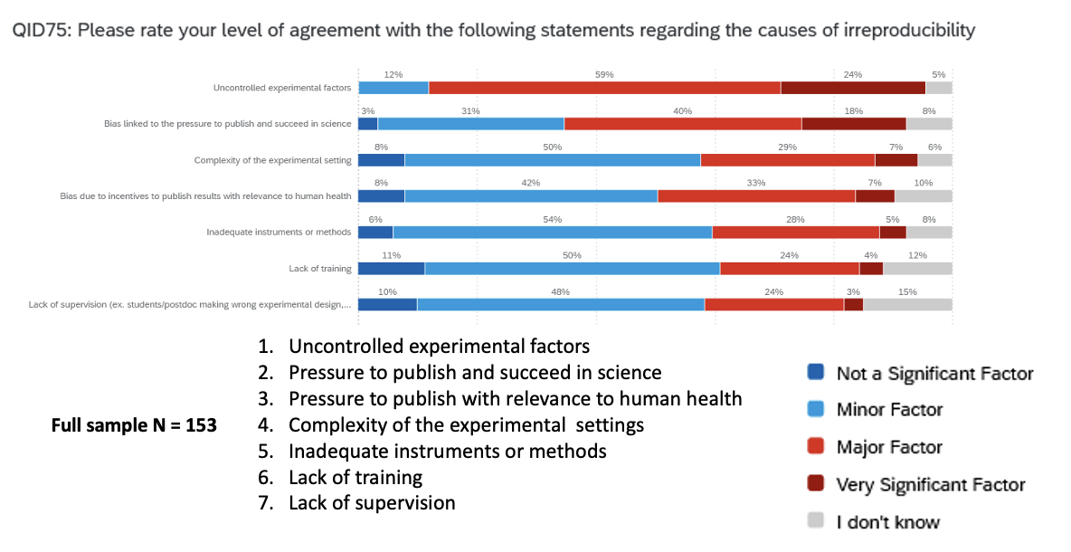
Psychology Part
Perceived causes of irreproducibility

Slide 22
Psychology Part
Claim 1:
The Toll homolog 18-wheeler contributes to AMP gene expression in response to LPS.

Slide 23
Psychology Part
Claim 1: The Toll homolog 18-wheeler contributes to AMP gene expression in response to LPS.

Slide 24
Psychology Part
Claim 1: The Toll homolog 18-wheeler contributes to AMP gene expression in response to LPS.

Slide 25
Psychology Part
Claim 2:
PGRP-SD is a pattern-recognition receptor acting upstream of the Toll pathway.

Slide 26
Psychology Part
Claim 2:
PGRP-SD is a pattern-recognition receptor acting upstream of the Toll pathway.

Slide 27
Psychology Part
Claim 2: PGRP-SD is a pattern-recognition receptor acting upstream of the Toll pathway.

Slide 28
Psychology Part
Evaluation of claims by the expert community: How well did they do?

Slide 29
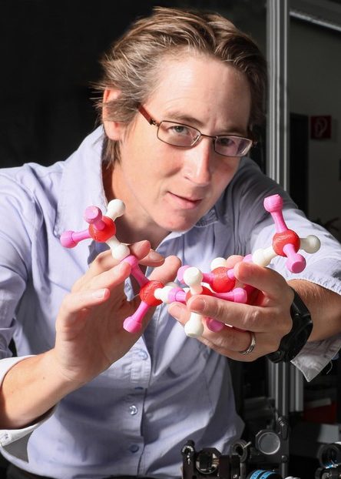
OUTLINE
Background Information
Metascience Part
Psychology Part
Closing & Next Steps

Slide 30

Closing & Next Steps
Closing
Drosophila immunity claims are quite reproducible
Pattern of irreproducibility: higher in high impact journals,
Significant fraction of unchallenged are in fact challenged: phenomenon of “big story” without any following up studies
Only few people accessed the website so far=> lack of interest in the community to discuss about past science findings
=> Our hypotheses: people focus on short term results, publishing papers to get THE job => do we have the wrong incentives?

Slide 31

Closing & Next Steps
Next Steps
Analyzing if irreproducible claims are clustered around specific labs, locations, people, age, experience, and stages of career
Publish summary of irreproducible claims in Drosophila immunity
Further analyze the data from the survey
Organize semi-structured interviews with scientists
Any feedback or ideas?

Slide 32
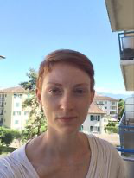
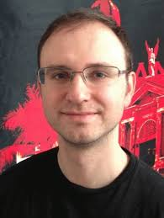
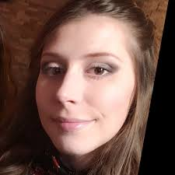
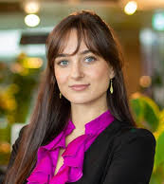
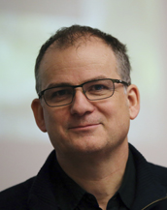

Thank you for listening!
Hannah Westlake
Fabrice David
Blandine Ribotta
Désirée Popelka
Bruno Lemaire
Experimental work:
Thomas Esmangart de Bournonville, Alexia Carboni, Claudia Melcarne, Tisheng Shan, Yang Wang, Liza Juravlev3, Nadia Pirko, Asya Dolgikh, Samuel Rommelaere, Faustine Rickebusch, Yao Tian, Akshata Kotwal, Kenan Krakovic, Sveta Chakrabarti, Jean Philippe Boquete; Fanny Schüpfer, Mark Hanson, Samuel Rommelaere, Shu Kondo, Haobo Jiang4 Francesca Di Cara, Estee Kurant

